Slide 1
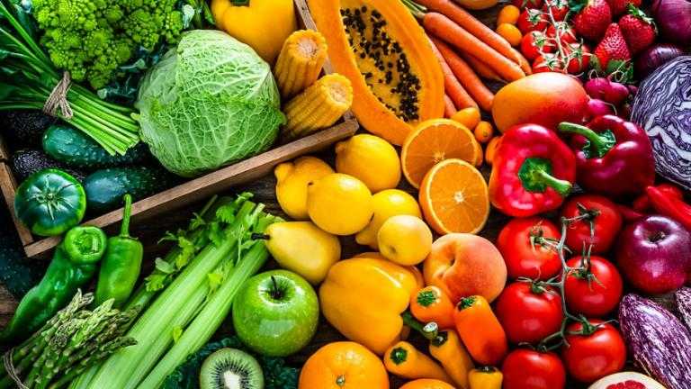
Classifying fruits/vege preferences based on images
Julian Bravo 20224540
Foong Lik Huan 20229521

Slide 2
Table of contents
01
02
03
04
05
06
Introduction
Motivation
Data and processing
Model (selection/training)
Eval/Discussion
Conclusion/Future work

Slide 3
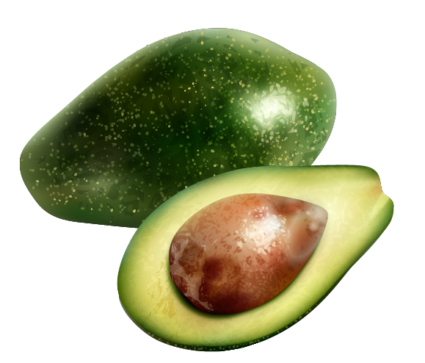
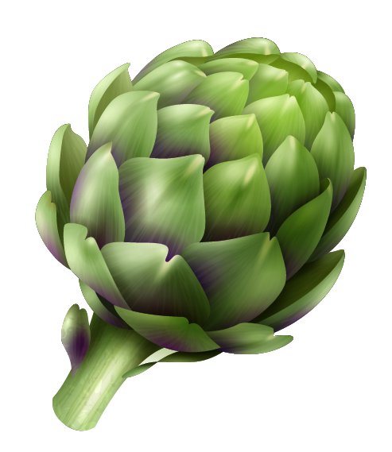
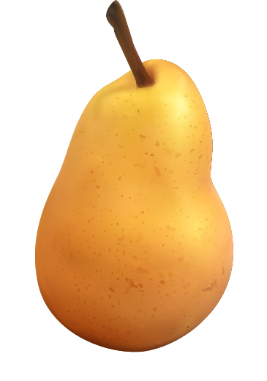
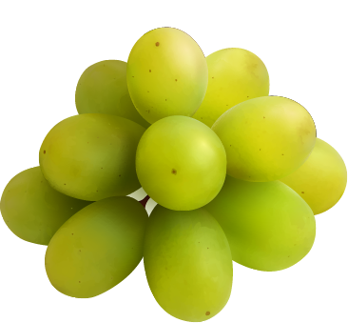
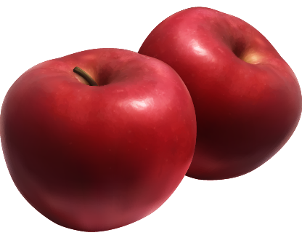
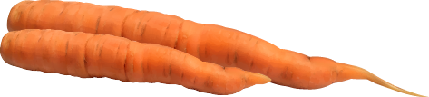
01
Introduction

Slide 4

Introduction
What is hugging face?
company and an open-source community
natural language processing (NLP) and machine learning
Models made by the community for use and share
Tutorials, blogs, and Community discussions
Well known for
Transformers library, Tokenization library
- Provides many pre-trained models for NLP tasks
- Tokenizers library for efficient tokenization
- Datasets library:
- load datasets in a single line of code,
- Use your own or use HuggingFace data

Slide 5
Introduction
Why is it important?
Easy integration
Easy to use API interfaces and libraries for coding
Lower barrier of entry for whoever to state-of-the-art pre-trained models
Open source and community engagement
Repositories on platforms (Github) facilitates collaboration
Community interacts with one another to have discussions
- Sharing knowledge, troubleshooting,..etc
- How to Guides and Notebooks

Slide 6
Introduction
How can pretrained models contribute to DS and AI?
Transfer Learning:
- Taking a pre-trained model and fine-tuning it (What we are doing)
- Reduces time and effort to achieve goal
- Lower barrier of entry, no need to build model from scratch
Feature Extraction:
- Pre-trained models capture rich hierarchical features from raw data
- used as feature extractors, learning from earlier layers

Slide 7
02
Motivation

Slide 8
Problem motivation
Problem:
Solution:
There is no current system that recommends us fruits/vegetables via images
Create a model that predicts whether we like a certain fruit/vegetables.
Main Question:
Hypothesis
Will image classification be able to predict our preferences based solely on images provided to it during its training phase.
This model will be able to learn our preferences based on its appearance and produce accurate predictions.

Slide 9

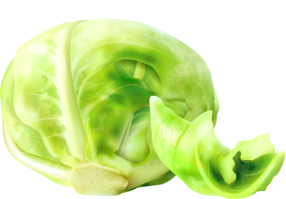
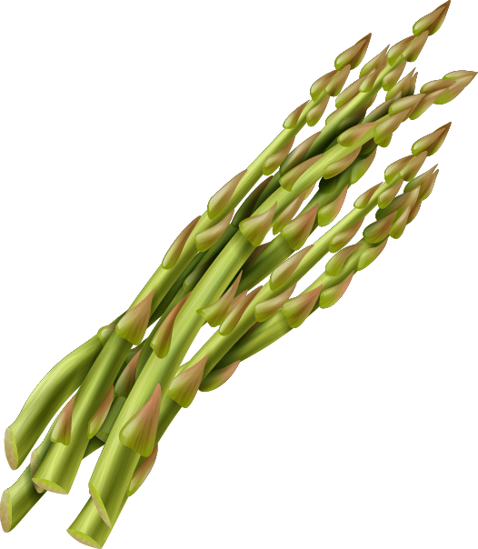
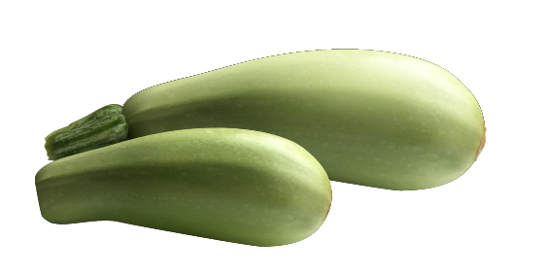
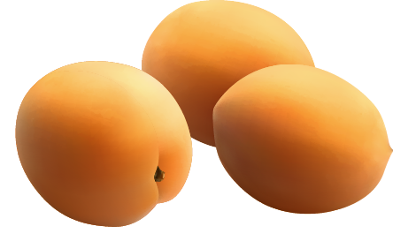
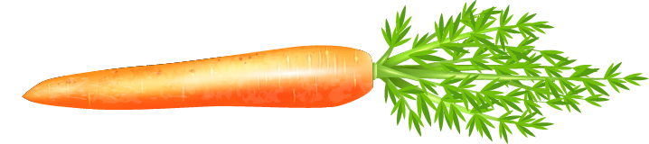
Problem Motivation
Why is this important to DS and AI?
If preference could be determined visually
Further push recommendation systems
Google, tabelog
Recommend users preferred food choices/ restaurants utilizing images

Slide 10
03
Data and processing

Slide 11
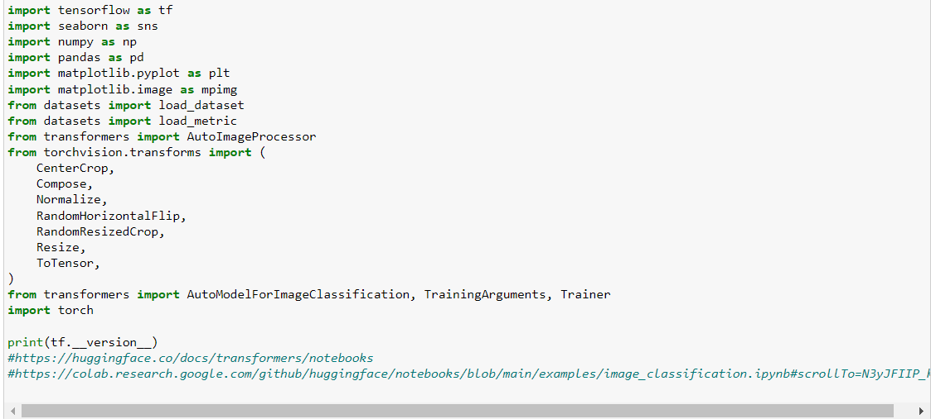
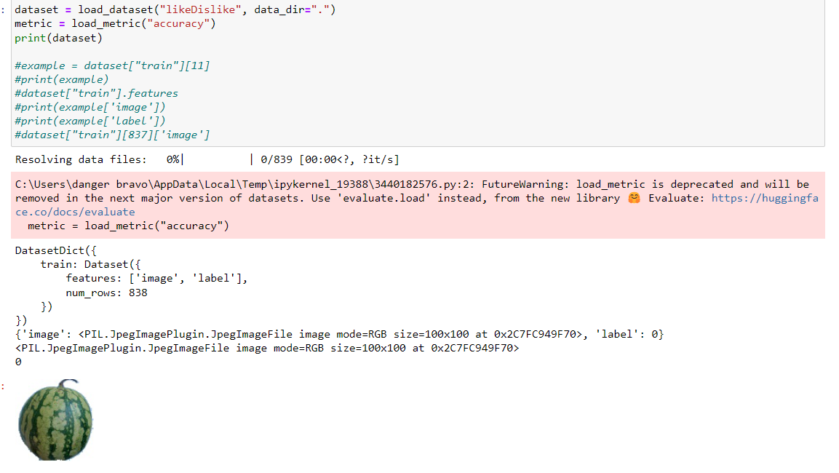
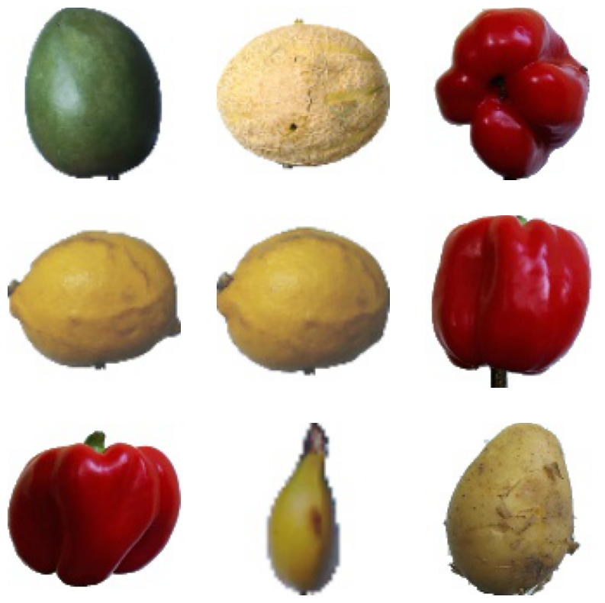
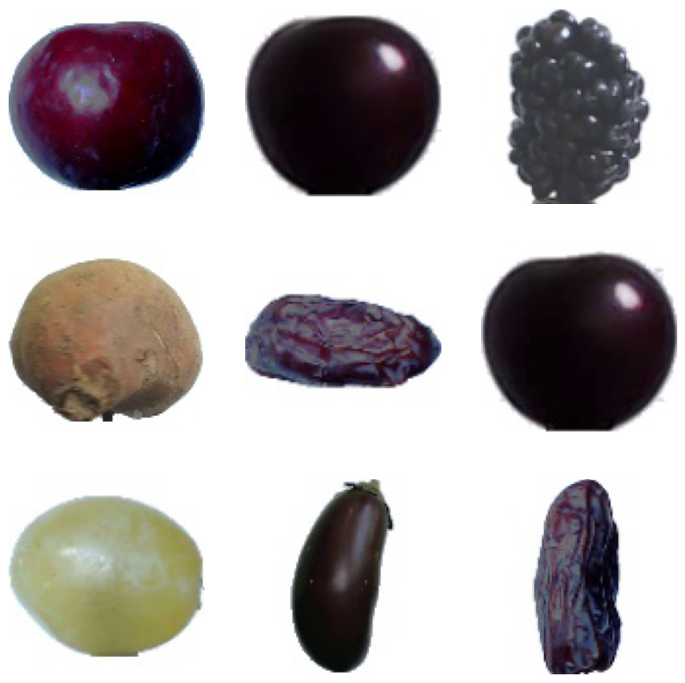
Data and processing
1) Import All the libraries required
2) Dataset library to load our images and labels

Slide 12
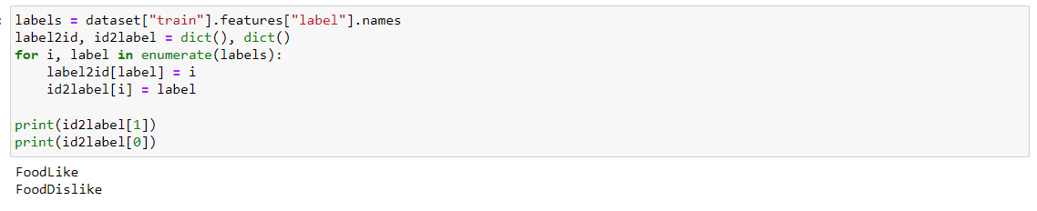
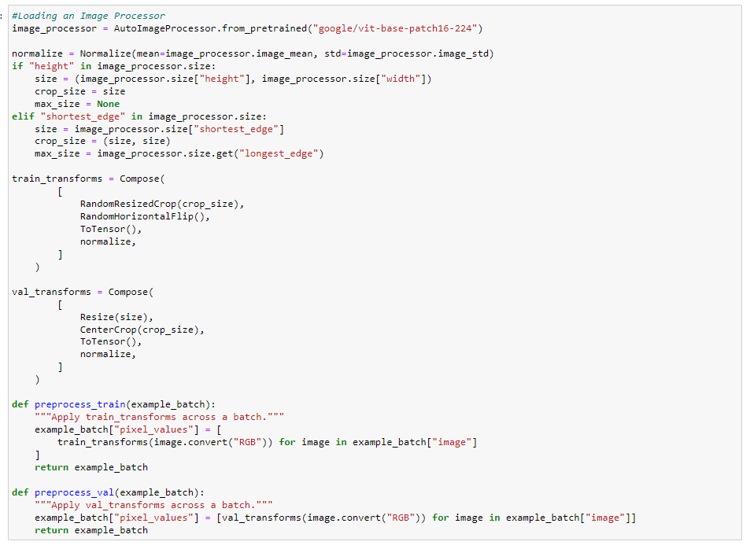
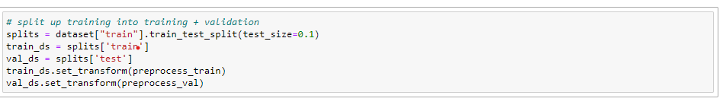
Data and processing
1) From our database create Dic where labels are 0 or 1
2) Load model. Resize, flip, cropping, color
label2id = {'FoodDislike': 0, 'FoodLike': 1}
Id2label = {0: 'FoodDislike', 1: 'FoodLike'}
3) Split into Train and validation sets

Slide 13
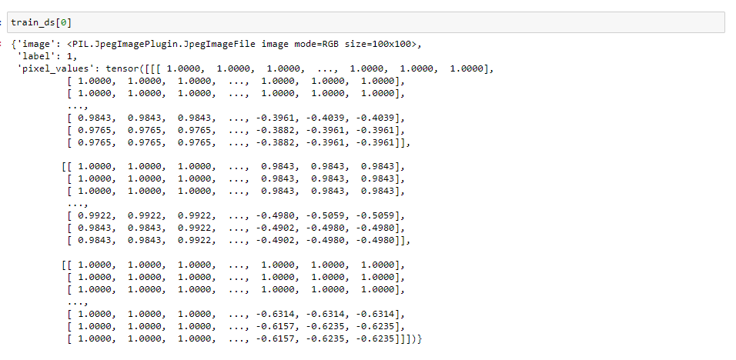
Data and processing

Slide 14
04
Model (Selection/Training)

Slide 15
Model (Selection/Training)
Project Design
Goal:
Test whether an image classifier model could predict fruit/vegetable preferences based on images.
Why this model:
This model made classifications based upon images.
Figured that we could train and use it to classify fruits/vegetables into ‘like’ and ‘dislike’ categories.

Slide 16
Model (Training)
Training the model
Dataset
Concept
Trained the model on fruits and vegetables that we dislike and liked.
We created the class labels “Like” and “Dislike” for the model to seperate them.
Dataset provided by Fruits-360
Split the dataset into 70/30 (70 to train and 30 to test)
The number of liked and disliked fruits were approx the same
The model is specific to individuals
Personalized preferences will be taught to the model
In return, personalized recommendations can be made

Slide 17
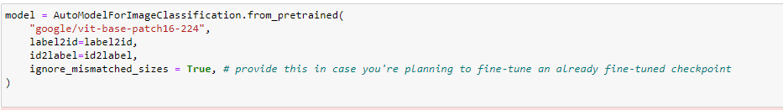
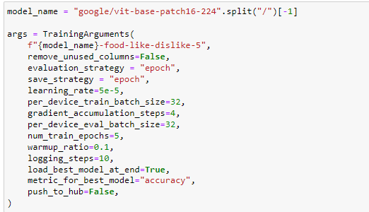
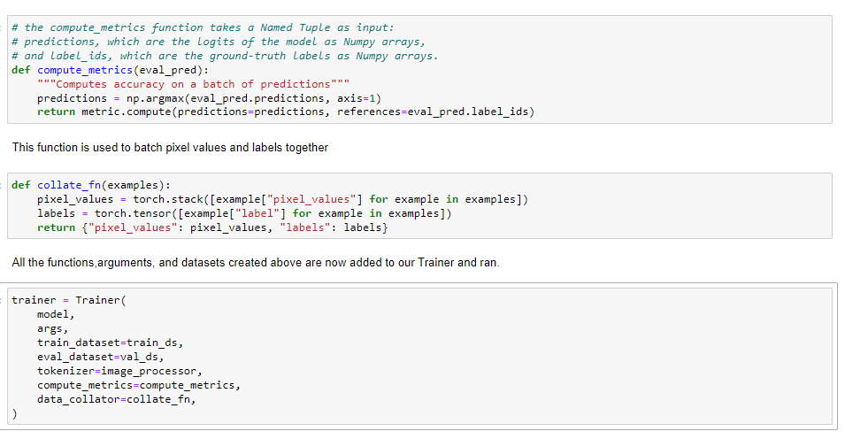
Model (Training)
2)Defining the Training Arguments: model's name, how we are evaluating our model, batch size, number of epochs to run, and whether we want to submit it online.
1)Load model and add the new labels
3) Function combine labels and pixel values and metrics

Slide 18
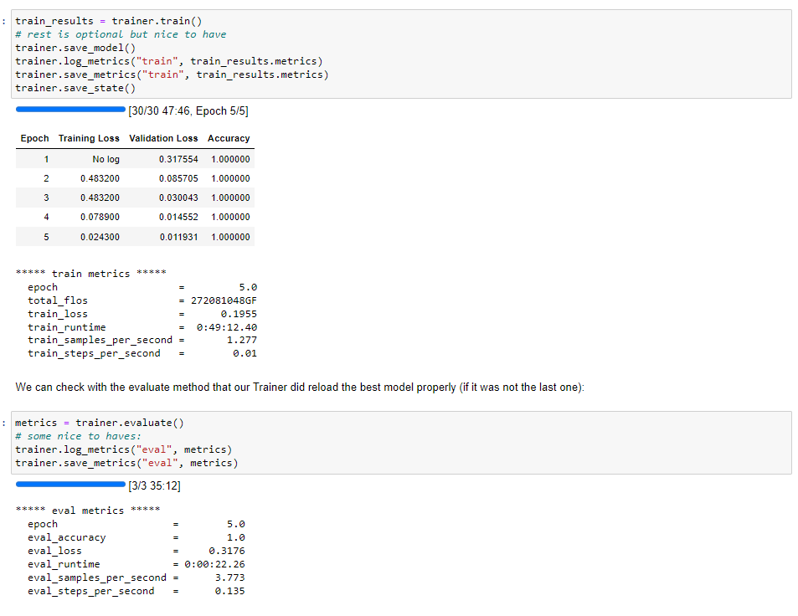
Model (Training)
Training results: We can see our model ran below and see specifics in how each epoch changed our model. Accuracy remained the same, Validation Loss decreased, and Traning Loss decreased, so we know our model improved each epoch.

Slide 19
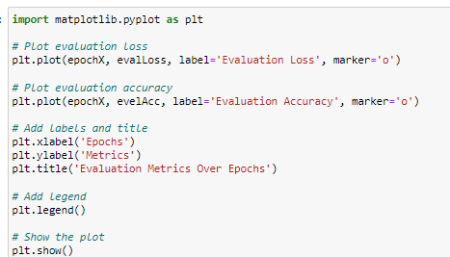
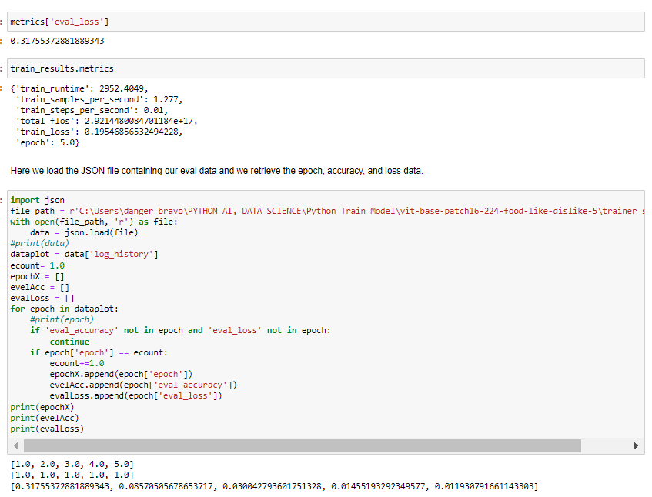
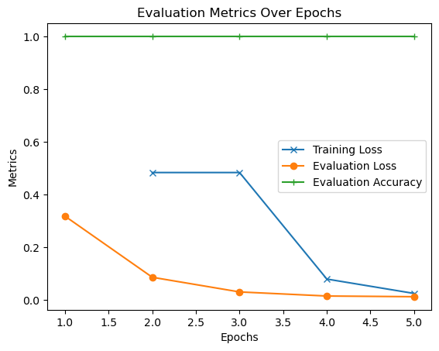
Model (Results)

Slide 20
05
Evaluation and Discussion

Slide 21
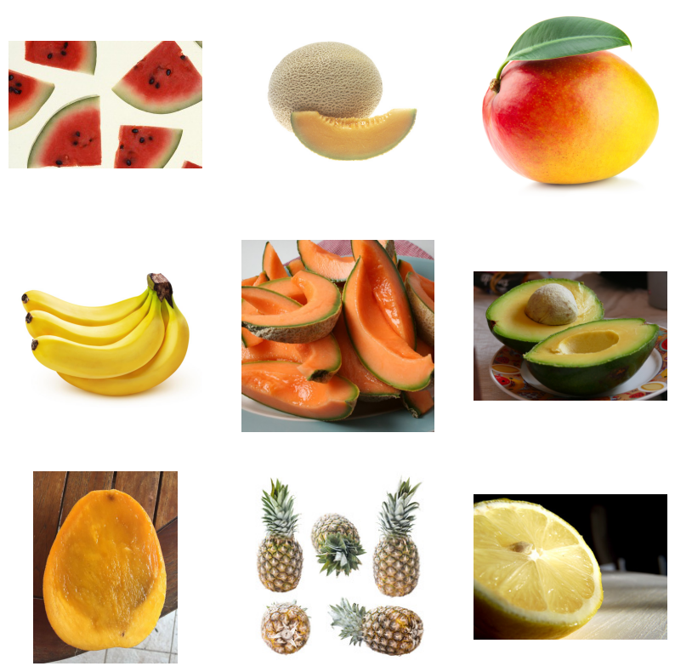
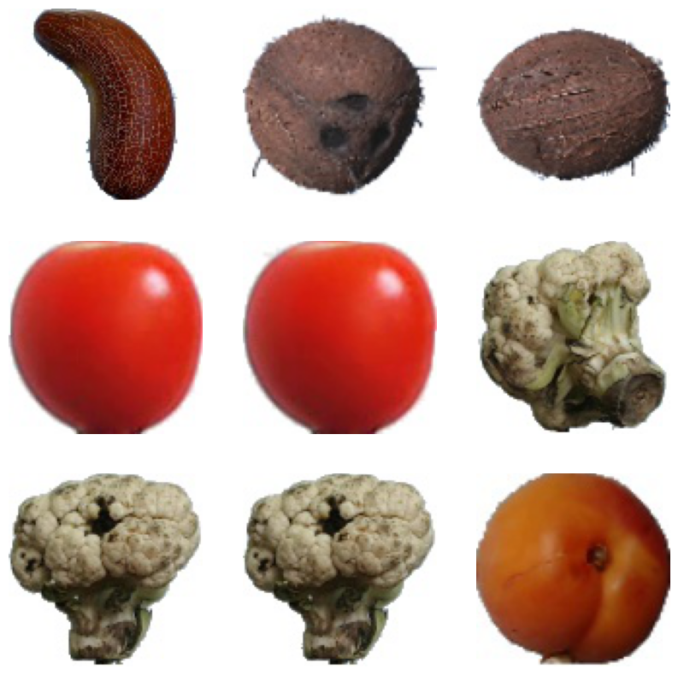
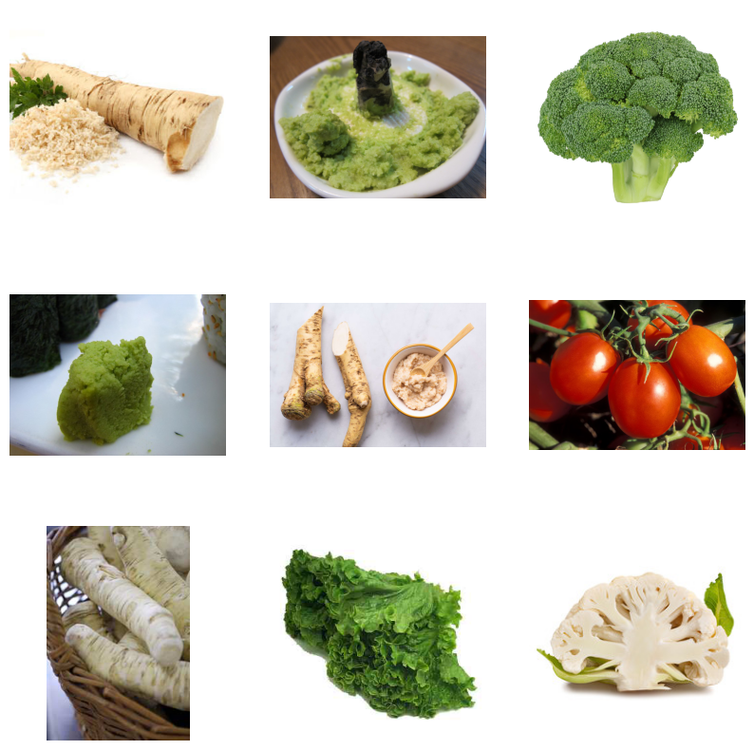
Model (Evaluation)
Evaluation methods
Method 1:
First tested it against out test dataset.
Fed the model images from the same dataset and label to see accuracy
Method 2:
Tested against different dataset.
Fed the model images with the same fruit/vegetables
Method 3:
Tested against against our test dataset.
Fed the model images with different fruit/vegetables
Method 4:
Tested against different dataset.
Fed the model images with different fruit/vegetables

Slide 22
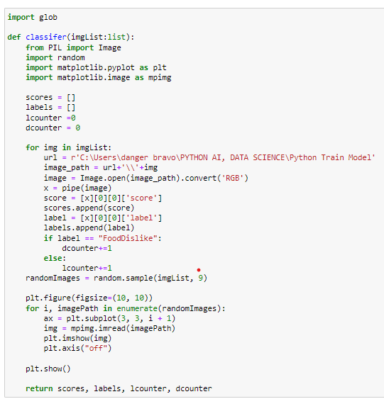
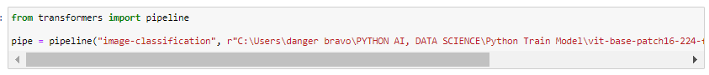
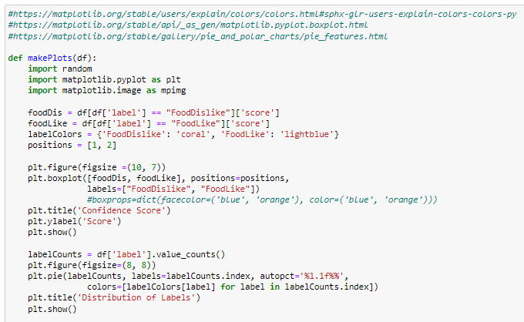
Model (Evaluation)
2) Classifier Function: retrieve data
Run pur new model as a pipeline
3) makePlots function: Plot our data

Slide 23
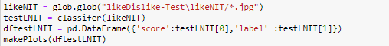
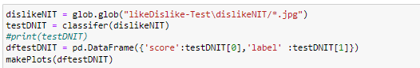
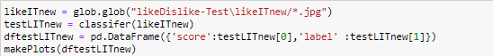
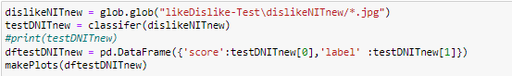
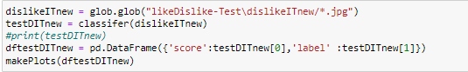
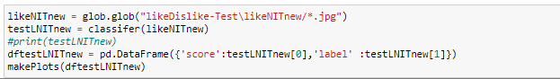
Results and discussion
Slide 24-25
Slide 28-29
Slide 26-27
Slide 30-31

Slide 24
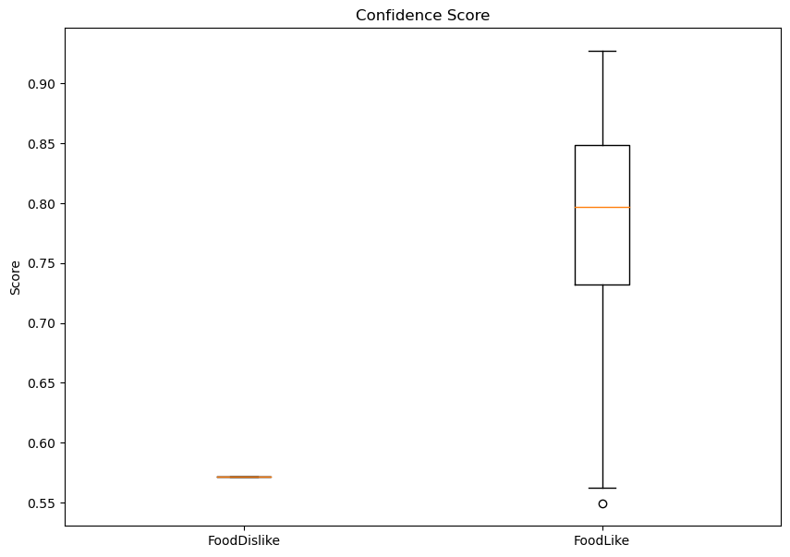
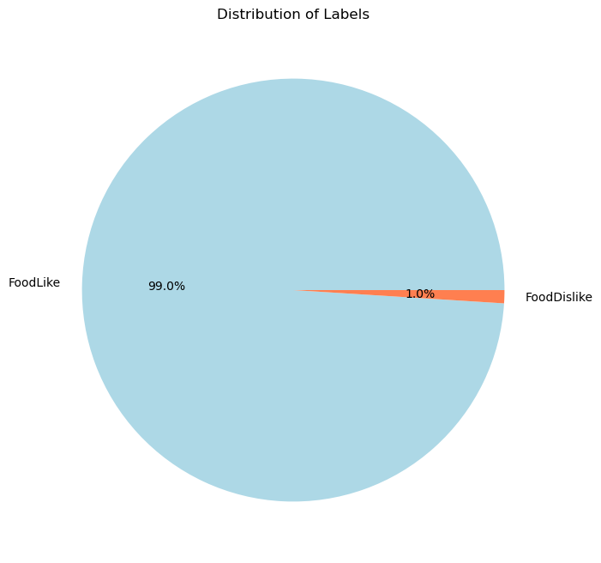
Test1: Like - Same label / dataset
Img Type Used
Pie Chart: Label %
Box Plot: Like/Dislike
Images from same Dataset.
Label: FoodLike
Prediction Labels-
FoodLike: 99%
FoodDislike: 1%
Min: .57
Max: .57
Median: .57
Min: .55
Max: .93
Median: .80

Slide 25
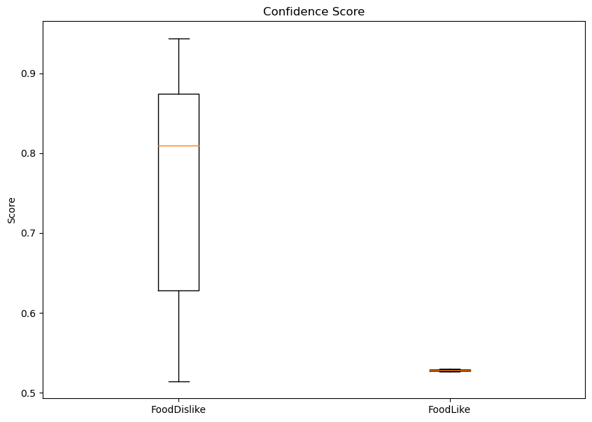
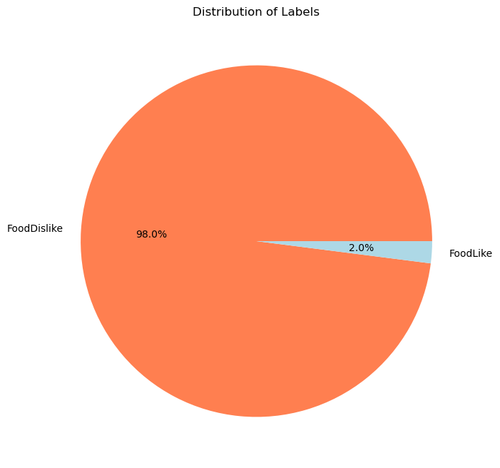
Test2: Dislike - Same label / dataset
Img Type Used
Pie Chart: Label %
Box Plot: Like/Dislike
Images from same Dataset.
Label: FoodDislike
Prediction Labels-
FoodLike: 2%
FoodDislike: 98%
Min: .51
Max: .94
Median: .81
Min: .53
Max: .53
Median: .53

Slide 26
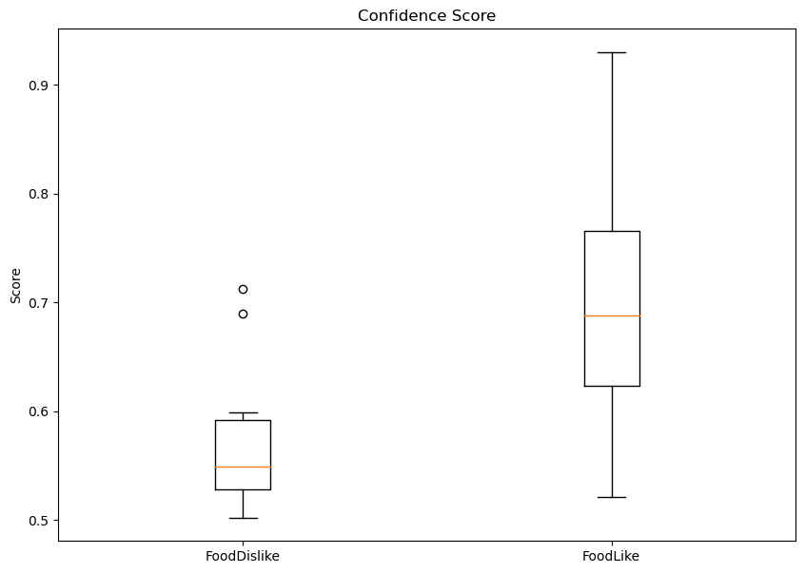
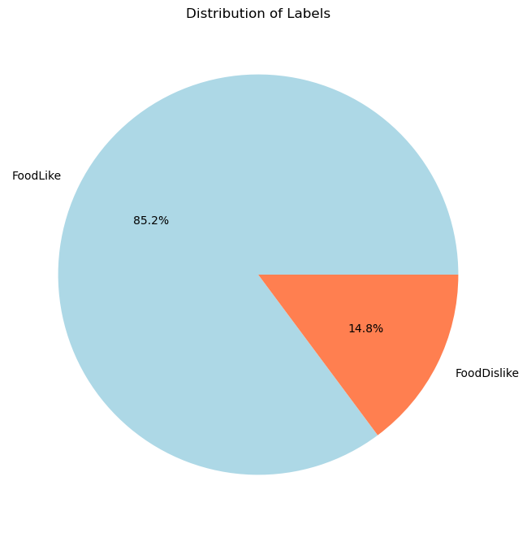
Test3: Like - Same label, new dataset
Img Type Used
Pie Chart: Label %
Box Plot: Like/Dislike
Imgs from a new Dataset. Fruit/Veg are same
Label: FoodLike
Prediction Labels-
FoodLike: 85%
FoodDislike: 15%
Min: .50
Max: .71
Median: .55
Min: .52
Max: .93
Median: .69

Slide 27
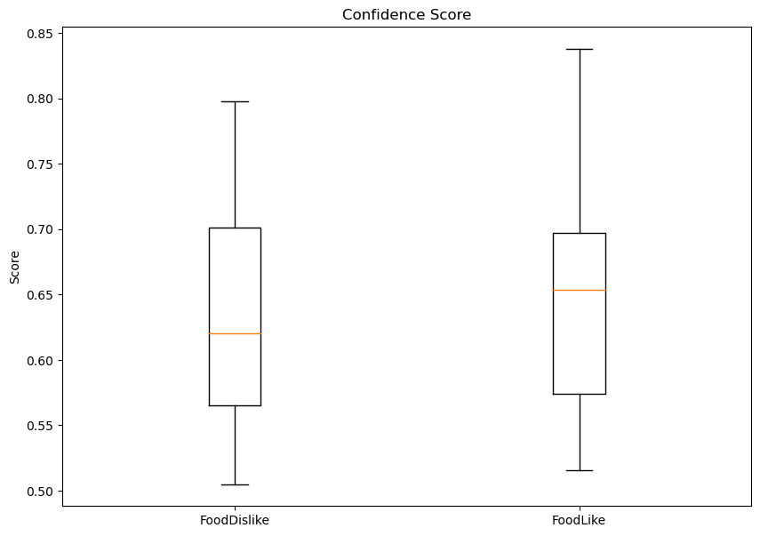
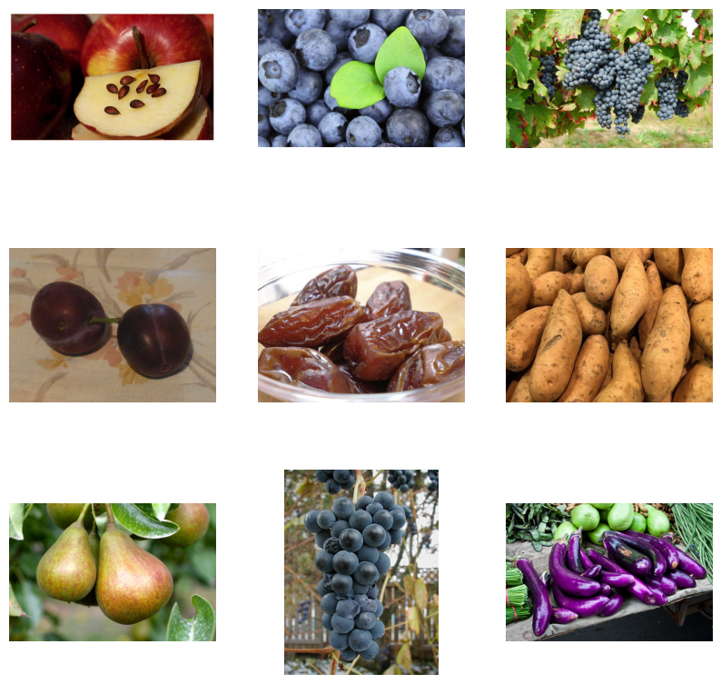
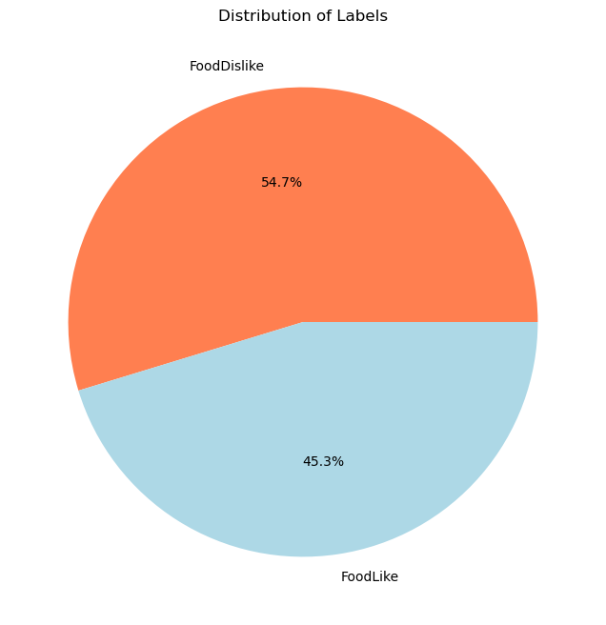
Test4: Dislike - Same label, new dataset
Img Type Used
Pie Chart: Label %
Box Plot: Like/Dislike
Imgs from a new Dataset. Fruit/Veg are same
Label: FoodDislike
Prediction Labels-
FoodLike: 45%
FoodDislike: 54%
Min: .50
Max: .80
Median: .62
Min: .52
Max: .84
Median: .65

Slide 28
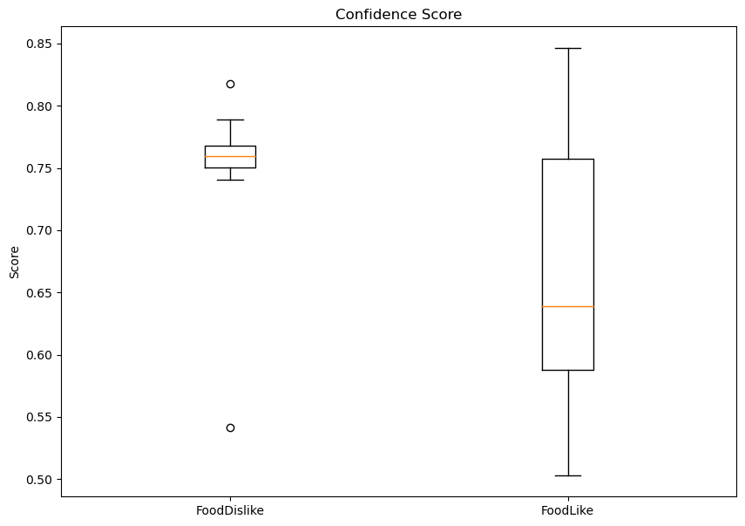
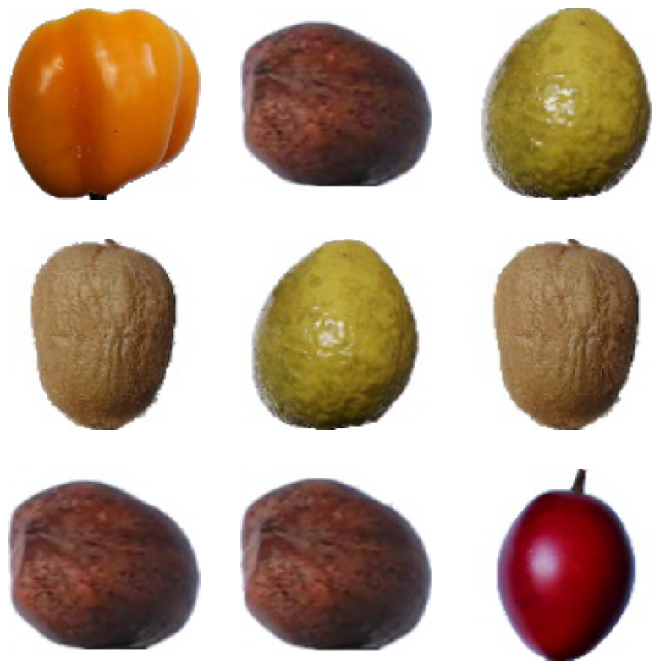

Test5: Like - Same label, new dataset
Img Type Used
Pie Chart: Label %
Box Plot: Like/Dislike
Imgs from same Dataset. Fruit/Veg are different
Label: FoodLike
Prediction Labels-
FoodLike: 84%
FoodDislike: 16%
Min: .54
Max: .82
Median: .76
Min: .50
Max: .85
Median: .64

Slide 29


Test6: Dislike - Same label, new dataset
Img Type Used
Pie Chart: Label %
Box Plot: Like/Dislike
Imgs from same Dataset. Fruit/Veg are different
Label: FoodDislike
Prediction Labels-
FoodLike: 68%
FoodDislike: 32%
Min: .51
Max: .69
Median: .62
Min: .50
Max: .77
Median: .66

Slide 30



Test7: Like - Same label, new dataset
Img Type Used
Pie Chart: Label %
Box Plot: Like/Dislike
Imgs from diff Dataset. Fruit/Veg are different
Label: FoodLike
Prediction Labels-
FoodLike: 56%
FoodDislike: 44%
Min: .50
Max: .71
Median: .55
Min: .52
Max: .93
Median: .69

Slide 31


Test8: Dislike - Same label, new dataset
Img Type Used
Pie Chart: Label %
Box Plot: Like/Dislike
Imgs from diff Dataset. Fruit/Veg are different
Label: FoodDislike
Prediction Labels-
FoodLike: 69%
FoodDislike: 31%
Min: .50
Max: .68
Median: .58
Min: .53
Max: .80
Median: .67

Slide 32


Results and discussion
Getting the accuracy scores
For bar plots on slides 33-34

Slide 33


Results and discussion
The follow bar plots are the accuracy scores of each test. The highest score is 1 (100% accuracy)
Red: Training Data(IT)
Green:
Testing Data (ITNEW)
Blue:
Other sources of fruits/ vege in training data (NotIT)
Yellow:
Other fruits/vege not in data (NotITnew)
This bar plot shows the accuracy in predicting liked.
The accuracy for ITnew and NotIT is fairly accurate with a 0.8.
The accuracy for NotITnew is fairly low with approx a 0.6
This bar plot shows the accuracy in predicting disliked.
The accuracy for ITnew is fairly low at approx 0.6
The accuracy for NotIT and NotITnew are both low with approx 0.3

Slide 34
Results and discussion
The follow bar plots are the accuracy scores of each test. The highest score is 1 (100% accuracy)
Red: Training Data(IT)
Green:
Testing Data (ITNEW)
Blue:
Other sources of fruits/ vege in training data (NotIT)
Yellow:
Other fruits/vege not in data (NotITnew)
The prediction accuracy for like disliked is generally higher. This might be due to distinct features of the fruits/vege in the disliked category, making it more obvious to the model.
As the score for NotITnew low, it is possible that the model is not very good at making predictions.
The act of making predictions based only on images might not be possible

Slide 35
06
Conclusion and Future work

Slide 36
Conclusion - Future Experiments
Predicting Food we liked was more accurate OVERALL
Predicting Food we disliked was less accurate
Predict well if the same fruits and vegetables were used as our Training
Potentially not enough diversity or too similar fruits / vegetables in our
training creating skewed bias
Determining how our dataset contributed to our results.
We believe 100x100 images on a white background result in a bad model
This might mean that images cannot work with abstract ideas like taste,
liking, or preferences.
Future work:
Potential for expanding into other areas like fashion, meals, or taste
Fashion: Given data on fashion one finds appealing we can predict if one would
Like / dislike clothing
Meals:Expand our small experiment into meal recognition
Taste: Can images tell you what something will be to your pallets’ liking?

Slide 37


Our team
Julian Bravo Jr
Foong Lik Huan
“I like spicy stuff, and potatoes but only if they're fried or smashed”
“I ate some good pizza, but that Chicken Burger is bussin”

Slide 38



Thanks!
Do you have any questions,
Comments, Concerns?
Please keep this slide for attribution

Slide 39
References
Horea Muresan, Mihai Oltean, Fruit recognition from images using deep learning, Acta Univ. Sapientiae, Informatica Vol. 10, Issue 1, pp. 26-42, 2018. Retrieved from: https://github.com/Horea94/Fruit-Images-Dataset
Hugging Face( n.d.) Fine-tuning for Image Classification with 🤗Transformers. Retrieved from: https://colab.research.google.com/github/huggingface/notebooks/blob/main/examples/image_classification.ipynb#scrollTo=N3yJFIIP_k01
Hugging Face (n.d.) Transformers Notebooks, Hugging Face Computer Vision. Retrieved from:https://huggingface.co/docs/transformers/notebooks
Matplotlib (2012) Box Plot. The Matplotlib development team. Retrieved from: https://matplotlib.org/stable/api/_as_gen/matplotlib.pyplot.boxplot.html
Matplotlib (2012) Pie charts. The Matplotlib development team. Retrieved from: https://matplotlib.org/stable/gallery/pie_and_polar_charts/pie_features.html
Matplotlib (2012) Specifying colors. The Matplotlib development team. Retrieved from: https://matplotlib.org/stable/users/explain/colors/colors.html#sphx-glr-users-explain-colors-colors-py

